Slide 1
Data Encryption Standard (DES)

Slide 2
Objectives
❏ To review a short history of DES
❏ To define the basic structure of DES
❏ To describe the details of building elements of DES
❏ To describe the round keys generation process
❏ To analyze DES

Slide 3
INTRODUCTION
The Data Encryption Standard (DES) is a symmetric-key block cipher published by the National Institute of Standards and Technology (NIST).
Topics discussed in this section:
5.1.1 History
5.1.2 Overview

Slide 4
5.1.1 History
In 1973, NIST published a request for proposals for a national symmetric-key cryptosystem. A proposal from IBM, a modification of a project called Lucifer, was accepted as DES. DES was published in the Federal Register in March 1975 as a draft of the Federal Information Processing Standard (FIPS).

Slide 5

5.1.2 Overview
DES is a block cipher, as shown in Figure 5.1.
Figure 5.1 Encryption and decryption with DES

Slide 6
5-2 DES STRUCTURE
The encryption process is made of two permutations (P-boxes), which we call initial and final permutations, and sixteen Feistel rounds.
Topics discussed in this section:
5.2.1 Initial and Final Permutations
5.2.2 Rounds
5.2.3 Cipher and Reverse Cipher
5.2.4 Examples

Slide 7

5-2 Continue
Figure 5.2 General structure of DES

Slide 8

5.2.1 Initial and Final Permutations
Figure 5.3 Initial and final permutation steps in DES

Slide 9
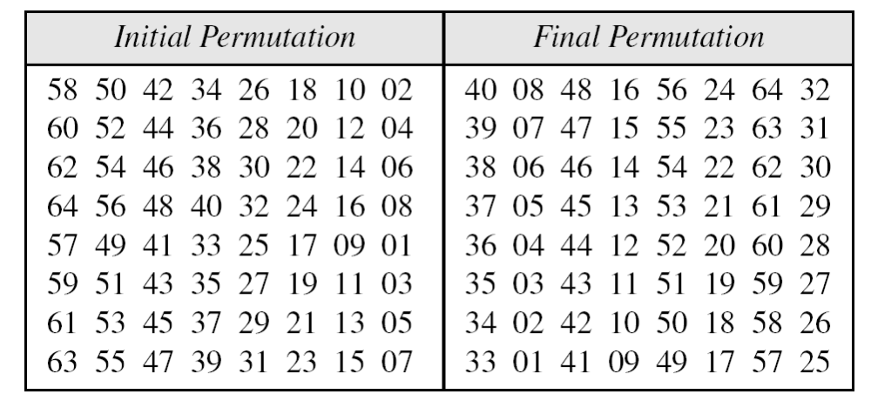
5.2.1 Continue
Table 5.1 Initial and final permutation tables

Slide 10
5.2.1 Continued
Example 5.2
Prove that the initial and final permutations are the inverse of each other by finding the output of the initial permutation if the input is

Slide 11

5.2.1 Continued
Note
The initial and final permutations are straight P-boxes that are inverses
of each other.
They have no cryptography significance in DES.

Slide 12

5.2.2 Rounds
DES uses 16 rounds. Each round of DES is a Feistel cipher.
Figure 5.4
A round in DES
(encryption site)

Slide 13

5.2.2 Continued
DES Function
The heart of DES is the DES function. The DES function applies a 48-bit key to the rightmost 32 bits to produce a 32-bit output.
Figure 5.5
DES function

Slide 14

5.2.2 Continue
Expansion P-box
Since R_{I−1} is a 32-bit input and K_{I} is a 48-bit key, we first need to expand R_{I−1} to 48 bits.
Figure 5.6 Expansion permutation

Slide 15
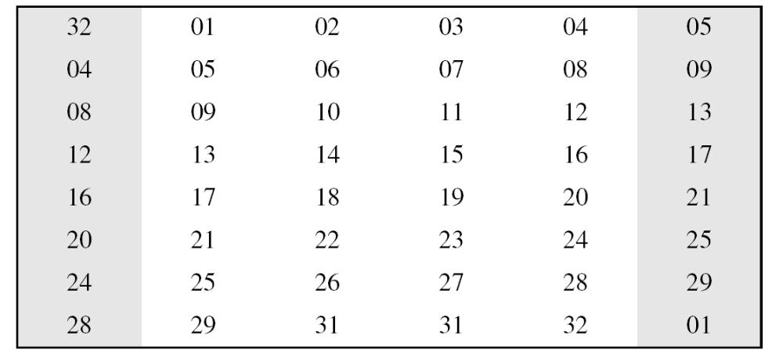
5.2.2 Continue
Although the relationship between the input and output can be defined mathematically, DES uses Table 6.2 to define this P-box.
Table 5.6 Expansion P-box table

Slide 16
5.2.2 Continue
Whitener (XOR)
After the expansion permutation, DES uses the XOR operation on the expanded right section and the round key. Note that both the right section and the key are 48-bits in length. Also note that the round key is used only in this operation.

Slide 17

5.2.2 Continue
S-Boxes
The S-boxes do the real mixing (confusion). DES uses 8 S-boxes, each with a 6-bit input and a 4-bit output. See Figure 6.7.
Figure 5.7 S-boxes

Slide 18

5.2.2 Continue
Figure 5.8 S-box rule
000010: 00, 0001: 1

Slide 19

5.2.2 Continue
Table 5.3 shows the permutation for S-box 1. For the rest of the boxes see the textbook.
Table 5.3 S-box 1

Slide 20
5.2.2 Continued
Example 5.3
The input to S-box 1 is 100011. What is the output?
Solution
If we write the first and the sixth bits together, we get 11 in binary, which is 3 in decimal. The remaining bits are 0001 in binary, which is 1 in decimal. We look for the value in row 3, column 1, in Table 6.3 (S-box 1). The result is 12 in decimal, which in binary is 1100. So the input 100011 yields the output 1100.

Slide 21
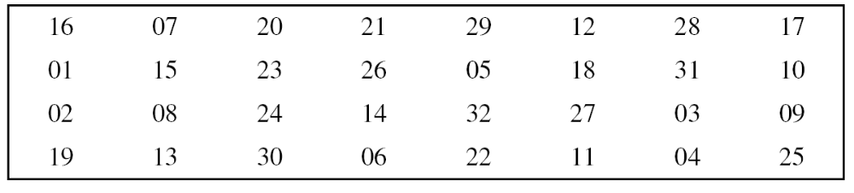
5.2.2 Continue
Straight Permutation
Table 5.11 Straight permutation table

Slide 22
5.2.3 Cipher and Reverse Cipher
Using mixers and swappers, we can create the cipher and reverse cipher, each having 16 rounds.
First Approach
To achieve this goal, one approach is to make the last round (round 16) different from the others; it has only a mixer and no swapper.
Note
In the first approach, there is no swapper in the last round.

Slide 23

5.2.3 Continued
Figure 5.9 DES cipher and reverse cipher for the first approach

Slide 24
5.2.3 Continued
Alternative Approach
We can make all 16 rounds the same by including one swapper to the 16th round and add an extra swapper after that (two swappers cancel the effect of each other).
Key Generation
The round-key generator creates sixteen 48-bit keys out of a 56-bit cipher key.

Slide 25

5.2.3 Continued
Figure 5.10
Key generation

Slide 26
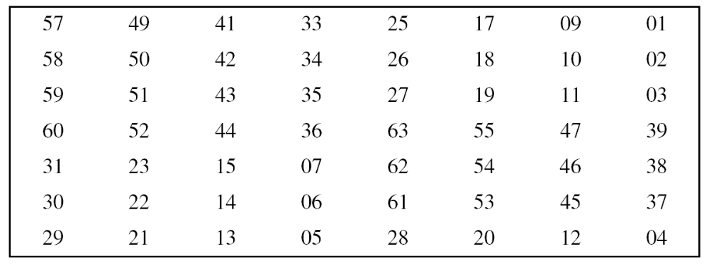
5.2.3 Continued
Table 5.12 Parity-bit drop table
Table 5.13 Number of bits shifts

Slide 27
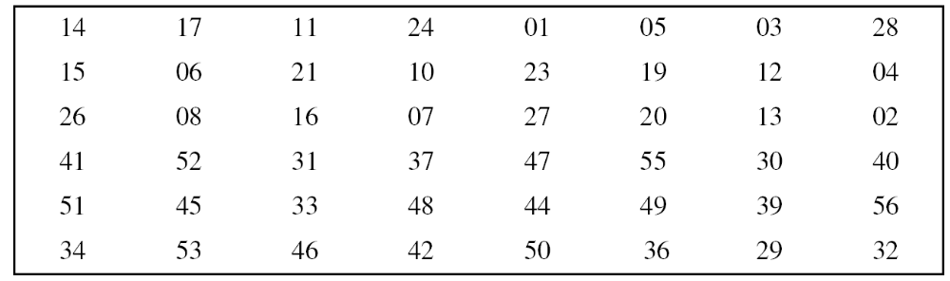
5.2.3 Continued
Table 5.14 Key-compression table

Slide 28
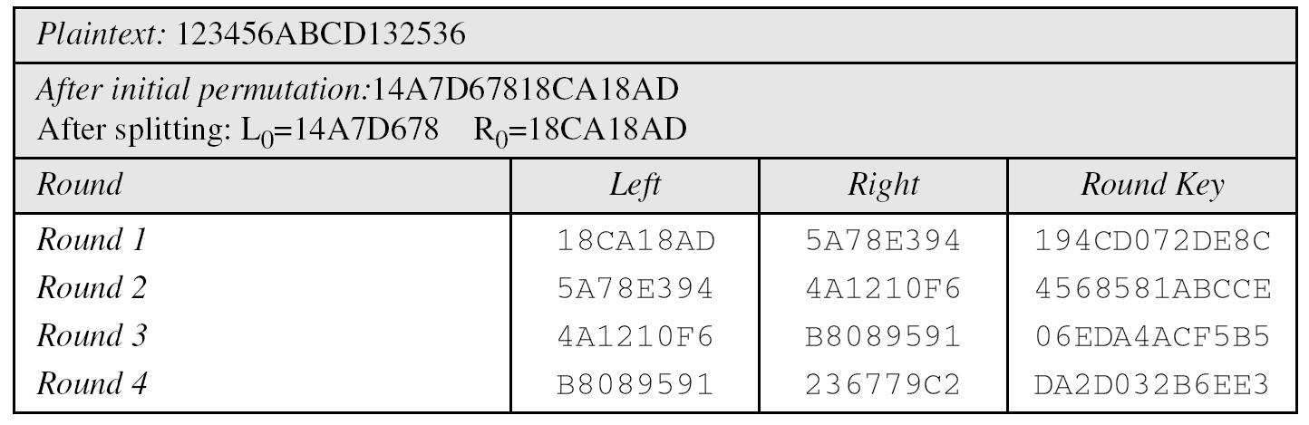
Examples
Example 5.5
We choose a random plaintext block and a random key, and determine what the ciphertext block would be (all in hexadecimal):
Table 5.15 Trace of data for Example 6.5

Slide 29
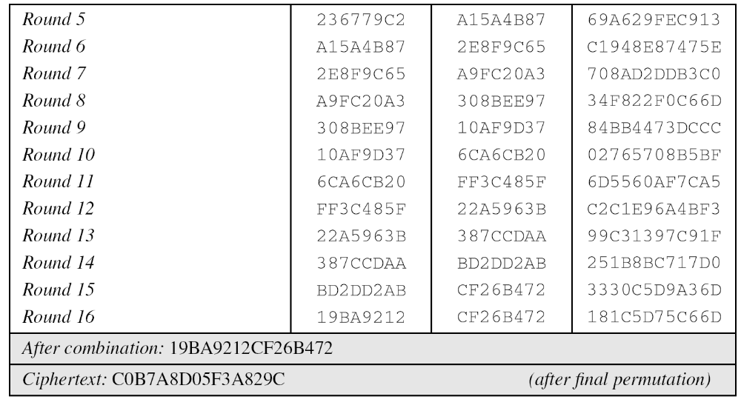
Continued
Example 5.5
Continued
Table 5.15 Trace of data for Example 6.5 (Conintued

Slide 30
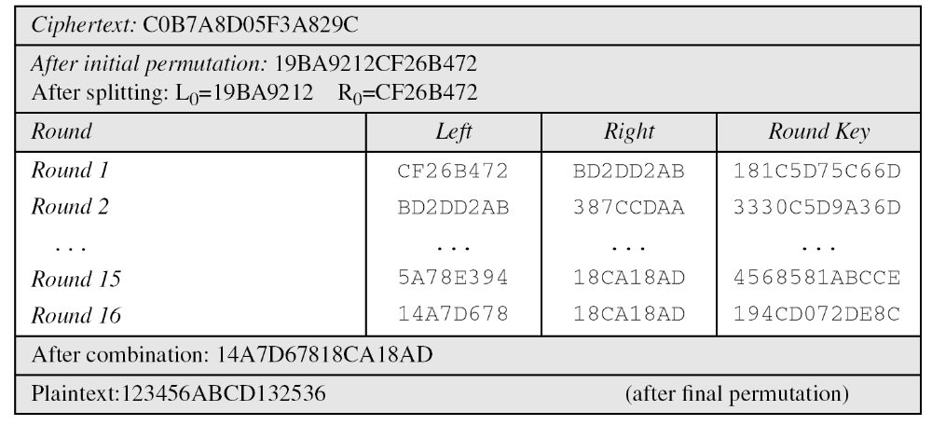
Continued
Example 5.6
Let us see how Bob, at the destination, can decipher the ciphertext received from Alice using the same key.

Slide 31
5-3 DES ANALYSIS
Critics have used a strong magnifier to analyze DES. Tests have been done to measure the strength of some desired properties in a block cipher.
Topics discussed in this section:
5.3.1 Properties
5.3.2 Design Criteria
5.3.3 DES Weaknesses

Slide 32
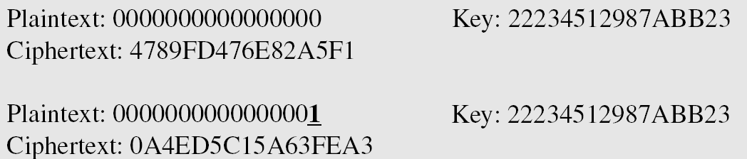
5.3.1 Properties
Two desired properties of a block cipher are the avalanche effect and the completeness.
Example 5.7
To check the avalanche effect in DES, let us encrypt two plaintext blocks (with the same key) that differ only in one bit and observe the differences in the number of bits in each round.

Slide 33
5.3.1 Continued
Example 5.7
Continued
Although the two plaintext blocks differ only in the rightmost bit, the ciphertext blocks differ in 29 bits. This means that changing approximately 1.5 percent of the plaintext creates a
change of approximately 45 percent in the ciphertext.

Slide 34
5.3.1 Continued
Completeness effect
Completeness effect means that each bit of the ciphertext needs to depend on many bits on the plaintext.

Slide 35
5.3.2 Design Criteria
S-Boxe
The design provides confusion and diffusion of bits from each round to the next.
P-Boxes
They provide diffusion of bits.
Number of Rounds
DES uses sixteen rounds of Feistel ciphers. the ciphertext is thoroughly a random function of plaintext and ciphertext.

Slide 36
5.3.3 DES Weaknesses
During the last few years critics have found some weaknesses in DES.
Weaknesses in Cipher Design
1. Weaknesses in S-boxes
2. Weaknesses in P-boxes
3. Weaknesses in Key

Slide 37
5-4 Multiple DES
The major criticism of DES regards its key length. Fortunately DES is not a group. This means that we can use double or triple DES to increase the key size.
Topics discussed in this section:
5.4.1 Double DES
5.4.4 Triple DES

Slide 38
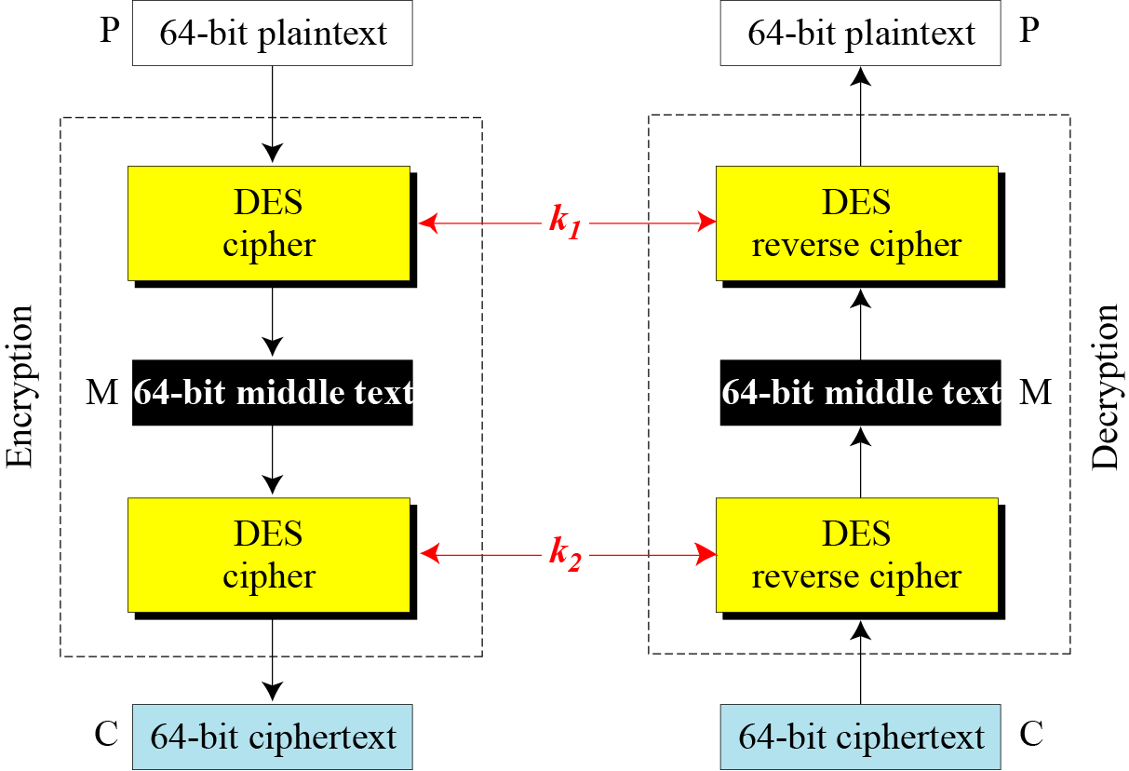
5.4.1 Continued
Figure 5.14 Double DES

Slide 39
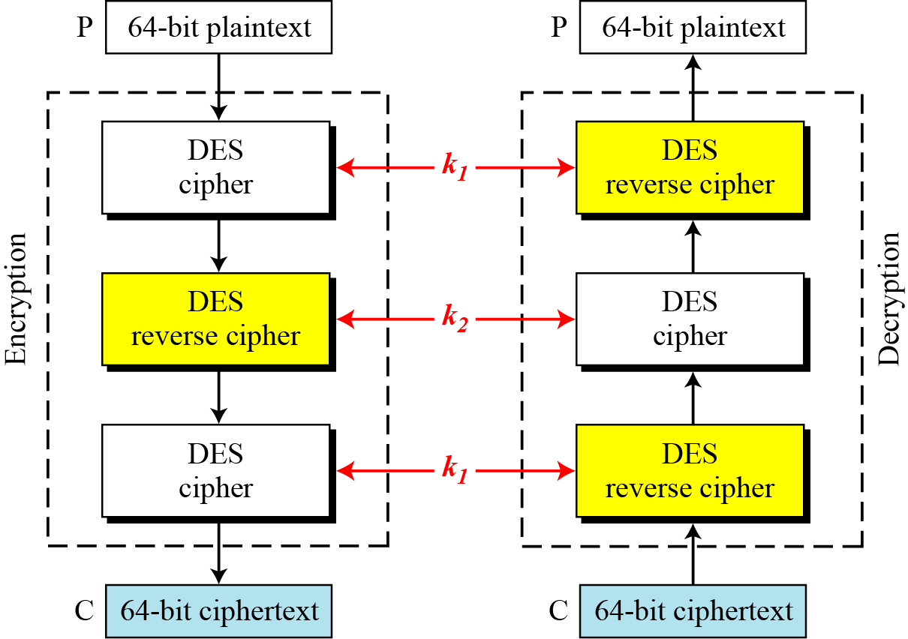
5.4.2 Triple DES
Figure 5.16 Triple DES with two keys

Slide 40
5.4.2 Continuous
Triple DES with Three Keys
The possibility of known-plaintext attacks on triple DES with two keys has enticed some applications to use triple DES with three keys. Triple DES with three keys is used by many applications such as PGP (See Chapter 16).
6.<number>

